Slide 1


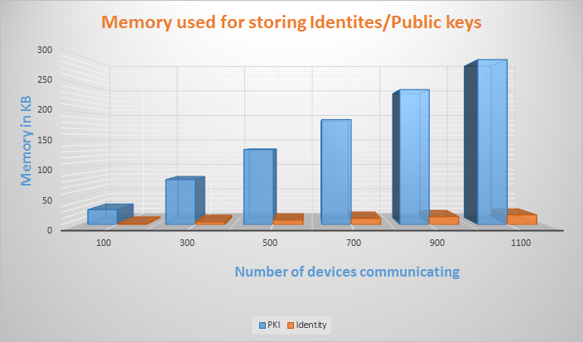

Identity based authentication for the Internet of Things (IoT)
KIRALE BHARATH ALVA - 18431364, YUVARAJ SRIPATHI – 14677313
Department of Computer and Information Science and Engineering
Email: {bharathalva, ysripath}@ufl.edu
Motivation
Design
Implementation
Result
Security threats for the Internet of Things continues to grow.
To suggest a better alternative to the usage of PKI in IoT.
Reduce vulnerabilities of the Public key crypto operations.
Public key crypto operations are not intended for raw data encryption.
To optimize crypto operations using Symmetric key encryption/decryption.
Broadcast of IP address from server to all nearby nodes.
Establishment of UDP socket connection between the communicating nodes.
A Key ‘K’ generated by random generator function to provide the server for encrypting the generated Identity and send it back to the corresponding client node.
Secure initial communication between end device and the server using the server’s public key.
Custom algorithm for Identity generation with MAC address and serial number as the seed at the server.
Encrypt the generated identity using the key `K’ provided by end device which requested for Identity creation.
Encryption/decryption in the client and the server is done using AES-128bit symmetric key algorithm..
Nonce is introduced in the form of a timestamp which indicates the validity of the identity on whose expiry the Server regenerates a new identity and communicates it to the corresponding client.
Simulation done in Contiki Cooja.
On using an Identity of size 16 bytes and using the same as the key for AES-128 bit symmetric key encryption/decryption against a public key of size 272 bytes reduces the memory consumed for storing them especially at the central server node and memory constrained end devices in the IoT environment.
For client-client communication, client 1 requests the Identity of client 2 from the server.
The request contains the requesting client’s name along with the name of the client whose identity is being requested which is encrypted using the requesting client’s Identity.
Server encrypts the requested client’s Identity using the Identity of the requesting client along with the timestamp.
To send a message to client 2, client 1 sends it’s Identity, message and timestamp encrypted using the Identity of client 2. Further communication between client 1 and client 2 makes use of each other’s Identity.
Corresponding communicating client’s Identities and timestamps are stored in a table.
Objectives
Implement a novel Identity based authentication scheme for IoT.
Identity used for authentication and symmetric key encryption/decryption purposes.
End devices will be able to decrypt the packets that they have received if and only if they are encrypted with its corresponding identity. This mechanism confirms the authenticity of the device in the other end that wants to communicate with it since identities are provided only by the server to the authentic devices in the same network.
The design also provides for resistance against man-in-the-middle and replay attacks.
Design
MAC address and serial number supplied by client to server along with the client name and a randomly generated key `K’ all encrypted using the public key of the server.
Random Identity is generated by the server using MAC address and serial number obtained.
Identity and timestamp is encrypted with the key ‘K’ and sent back to the client
Timestamp indicates the validity of the Identity.
Server provides the client with a new Identity once the timestamp is expired.
Server stores the name, MAC address, serial number and the Identity of every client along with the corresponding timestamp value.
Conclusion
We have managed to provide a better and robust method of authentication using randomly generated identities for each of the device against the usage of standard PKI by using the same entity (Identity) for both authentication and crypto operations.

